Slide 1
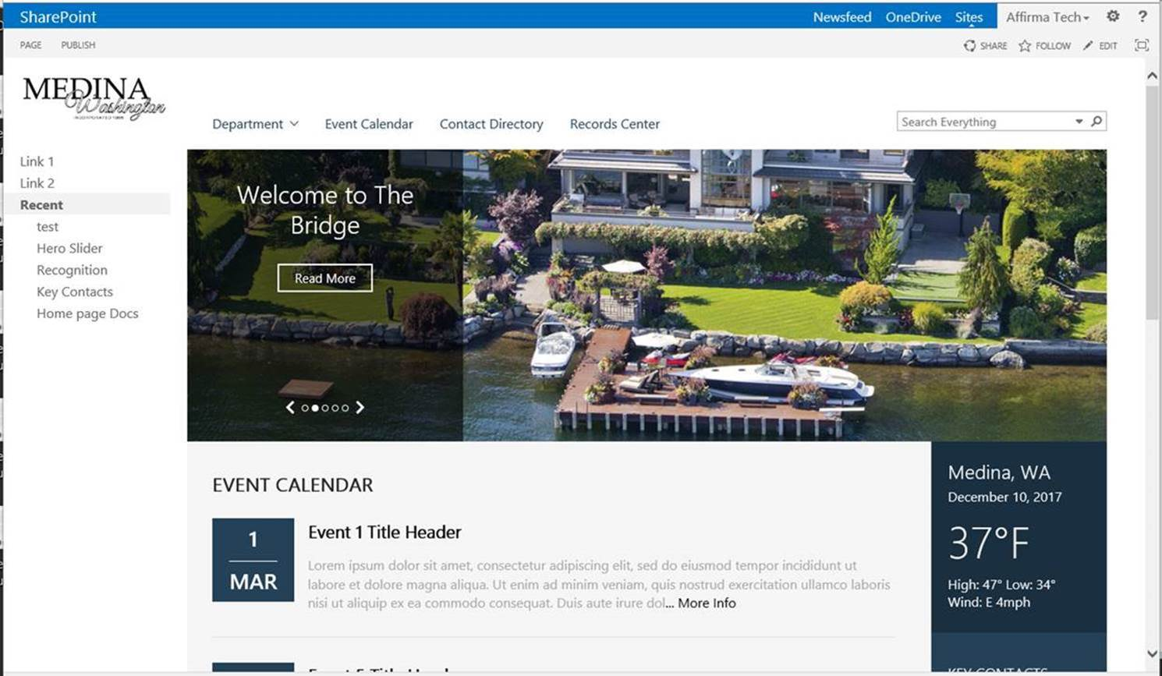
City of Medina - SP Implementation and Design
Project Description:
The City of Medina partnered with Affirma Consulting to design, build and deploy a SharePoint Intranet and Records Management solution. The scope included:
Design and build SharePoint server farm with 3 SharePoint servers, 1 SQL server and 1 OWA server
Installation and configuration of Gimmal Information Governance Suite and Gimmal Compliance Suite with File Plan Builder
Custom branded City of Medina Intranet user experience, “The Bridge.”
The Results:
The Affirma creative team met and collaborated with City of Medina stake holders to develop a custom branded intranet user experience that expresses the culture and natural beauty of the City of Medina.
Affirma engineers met with City of Medina records management officers and created a Records Center application integrated with the SharePoint Intranet.

